Slide 1
Lecture (10) Plant Physiology –By Dr. Manal Z.Sabti AL-Mayahyi
Respiration in the plant
In this Lecture we will discuss about:-
Contents:
Meaning of Respiration
Respiratory Substrates
Types of Respiration
Mechanism of Respiration
Oxidative Decarboxylation Pyruvic Acid
Krebs Cycle

Slide 2
Meaning of Respiration:
We know that during photosynthesis, light energy is converted into chemical energy, and is stored in carbohydrate molecules, such as glucose and starch. Organisms make use of such energy for their activities by oxidising these high energy food molecules into simple low energy molecules, i.e., carbon dioxide and water.
The reactions involved in process of oxidation are known as respiration. The compounds that are oxidised during process of respiration are called respiratory substrates.

Slide 3
Technically, Respiration is defined as follows:
This is a process by which living cells break down complex high energy food molecules into simple low energy molecules, i.e., CO₂ and H₂O, releasing the energy trapped within the chemical bonds.
The energy released during oxidation of energy rich compounds is made available for activities of cells through an intermediate compound called adenosine triphosphate (ATP).
During process of respiration, the whole of energy contained in respiratory substrates is not released all at a time.
It is released slowly in several steps of reactions controlled by different enzymes.

Slide 4
Respiration takes place in all types of living cells, and generally called cellular respiration. During the process of respiration oxygen is utilised, and CO2 water and energy are released as products. The released energy is utilised in various energy-requiring activities of the organisms, and the carbon dioxide released during respiration is used for biosynthesis of other molecules in the cell.
As we know, important life processes, such as synthesis of proteins, fats and carbohydrates, require a certain expenditure of energy. Where does this energy come from, how is it stored, and how is it made available to the living cell, are some of the questions, which are to be answered by process of respiration.
The reaction that occurs in common respiration of glucose may be summed up as follows:
Here, 686 kcal or 2870 kJ of energy is liberated per molecule of glucose. Formerly, this calculated value was 673 kcal. One kcal is equal to 1000 calories. This means that one molecule of glucose on complete oxidation yields 686 kcal (kilocalories) of energy, (i.e., 686, 000 calories).

Slide 5
The main facts associated with respiration are:
a. Consumption of atmospheric oxygen.
b. Oxidation and decomposition of a portion of the stored food resulting in a loss of dry weight as seen in the seeds germinating in dark.
c. Liberation of carbon dioxide and a small quantity of water (the volume of CO₂ liberated is equal to volume of O₂ consumed).
d. Release of energy by breakdown of organic food, (such as carbohydrates).

Slide 6
2. Respiratory Substrates:
Respiratory substrates are those organic substances which are oxidised during respiration. They are high energy compounds and are called respiratory substrates. They may be carbohydrates, fats and proteins. Carbohydrates, such as glucose, fructose (hexoses), sucrose (disaccharide) or starch, inulin, hemicellulose (polysaccharide), etc., are main respiratory substrates.
Besides, fats are used as respiratory substrates by a variety of organisms as they contain more energy than carbohydrates.
In rare circumstances, when carbohydrate reserves are exhausted, fats and proteins also serve as respiratory substrates. Blackman termed the respiratory oxidation of protoplasmic protein as protoplasmic respiration, while oxidation of carbohydrates as floating respiration.

Slide 7
3. Types of Respiration:
There are two main types of respiration:
(i) Aerobic, and
(ii) Anaerobic.
Aerobic Respiration:
This type of respiration leads to a complete oxidation of stored food (organic substances) in the presence of oxygen, and releases carbon dioxide, water and a large amount of energy present in respiratory substrate. Such type of respiration is generally found in higher organisms.
The overall equation is:
(ii) Anaerobic respiration:
This type of respiration occurs in complete absence of oxygen. In the absence of free oxygen, many tissues of higher plants, seeds in storage, fleshy fruits, and succulent plants, such as cacti temporarily take to a kind of respiration, called anaerobic respiration. Such respiration generally occurs in lower organisms like bacteria and fungi.

Slide 8
This results in incomplete oxidation of stored food and formation of carbon dioxide and ethyl alcohol, and sometimes also various organic acids, such as malic, citric, oxalic, tartaric, etc. Very little energy is released by this process to maintain activity of protoplasm.
The equation is as follows:
This process of oxidation in microbes is known as fermentation. This is quite similar to that of anaerobic respiration in case of higher plants.

Slide 9
4. Mechanism of Respiration:
There are two major phases of respiration:
(i) Glycolysis, and
(ii) Krebs cycle.
During process of respiration, carbohydrates are converted into pyruvic acid through a series of enzymatic reactions. This series of reactions is known as glycolysis which takes place in cytosol.
Now, pyruvic acid enters mitochondria, where several enzymes catalyse the reactions, and pyruvic acid finally converts into CO₂ and water. This series of enzymatic reactions is known as Krebs cycle (after name of its discoverer Sir Hans Adolf Krebs (1900-1981), awarded Nobel Prize in 1953), or tricarboxylic acid (TCA) or citric acid cycle.
Glycolysis:
Glycolysis is a term used to describe the sequential series of reactions present in a wide variety of tissues that starts with a hexose sugar (usually glucose) and ends with pyruvic acid. This term has originated from Greek words, glycos = sugar and lysis = splitting.
The scheme of glycolysis was discovered by three German Scientists, Gustav Embden, Otto Meyerhof and J. Parnas, and therefore, referred as EMP pathway, after the abbreviation of their last names.

Slide 10
Glycolysis is the first stage in the breakdown of glucose and is common to all organisms.
This means, glycolysis is common to both aerobic and anaerobic modes of respiration. In anaerobic organisms, this is only process in respiration. Glycolysis occurs in cytoplasm of cells. During this process, glucose undergoes partial oxidation to form two molecules of pyruvic acid.
In plants, glucose is derived from sucrose, which is the end product of photosynthetic carbon reactions (also known as dark reactions) or from storage carbohydrates.
Sucrose is converted into glucose and fructose by the enzyme invertase. Now, these two monosaccharides (i.e., glucose and fructose) enter glycolysis or EMP pathway.

Slide 11
The main steps of glycolytic pathway are as follows:
Glycolysis is carried out in following different steps:
a. Phosphorylation of Sugar (i.e., First Phosphorylation):
Glucose and fructose are phosphorylated to give rise to glucose-6-phosphate and fructose-6-phosphate, respectively, by the activity of enzyme hexokinase, in presence of ATR The phosphorylated form of glucose then isomerises to produce fructose-6-phosphate. Isomerisation takes place with the help of enzyme phosphohexose isomerase.
Further steps of metabolism of glucose and fructose are quite similar.
:

Slide 12
b. Phosphorylation of Fructose-6-Phosphate (i.e., Second Phosphorylation):
Now, fructose-6-phosphate is phosphorylated and fructose-1, 6-bisphosphate produced by the action of enzyme phosphofructokinase in presence of ATP.
c. Splitting:
Now, fructose- 1, 6-bisphosphate splits into two molecules of triose phosphate, i.e., 3-phosphoglyceraldehyde (PGAL) and dihydroxyacetone phosphate ( Di HAP ), which are interconvertible.
d. Oxidative Dehydrogenation:
After formation of 3-phosphoglycerldehyde (PGAL), the glycolytic pathway enters the energy conserving phase. Here, it is oxidized to a carboxylic acid, i.e., 1,3-bisphosphoglycerate, and NAD is reduced to NADH.

Slide 13
e. Formation of ATP:
In next step of glycolysis, 3-phosphoglycerate is formed from 1, 3-bisphosphoglycerate by enzymatic activity of phosphoglycerate kinase, and ATP is generated during this process. Direct synthesis of ATP from intermediate metabolites is called substrate level phosphorylsation.
This type of formation of ATP, where a phosphate group is directly transferred from a substrate to ADP to form ATP, is different from the ATP produced by ATP synthesis during oxidative phosphorylation in mitochondria or in chloroplasts (During photophosphorylation in photosynthesis).

Slide 14
f. Isomerisation:
In next step 3-phosphoglycerate converts into its isomer 2-phosphoglycerate by catalytic activity of enzyme phosphoglyceromutase.
g.
In subseqDehydration:uent step 2-phosphoglycerate converts into phosphoenol pyruvate (PEP) in the presence of enzyme pyruvate kinase and liberates ATP.

Slide 15
h. Generation and Utilization of ATP during Glycolysis:
During glycolytic pathway, the molecules of ATP are produced as follows:
(i) Direct transfer of phosphate to ATP.
(ii) Oxidation of NADH produced during glycolytic pathway to NAD⁺.
i. In the end of glycolysis net gain of ATP:
(i) During glycolysis two triose phosphate molecules are formed from one glucose molecule, and 4 ATP molecules are produced.
(ii) Out of 4 ATP molecules, 2 ATP molecules are utilised in first few steps in converting glucose to fructose-1, 6 bisphosphate.
(iii) Moreover, three ATP molecules are produced from oxidation of each of two molecules of NADH produced during catabolism of glucose.
(iv) In all, a net gain of 8 molecules occurs during process of glycolysis.
(v) However, in anaerobic respiration, NADH + H^ is not converted to ATP, and therefore, only 2 ATP molecules are produced.

Slide 16
5. Oxidative Decarboxylation Pyruvic Acid:
(Aerobic Oxidation of Pyruvic Acid)
Now, pyruvic acid generated in cytoplasm through glycolysis is transferred to mitochondria. This is initiation of second phase of respiration. As soon as, pyruvic acid enters the mitochondria, one of the three carbon atoms of pyruvic acid is oxidised to carbon dioxide in a reaction called oxidative decarboxylation.
Here, pyruvate is first decarboxylated, and thereafter oxidised by enzyme pyruvate dehydrogenase. This enzyme is made up of a decarboxylase, lipoic acid, TPP, transacetylase and Mg⁺².
Acetyl Co-A acts as substrate entrant for Krebs cycle.
The equation is as follows:
Acetyl Co-A can enter into mitochondria while pyruvate acid cannot.

Slide 17
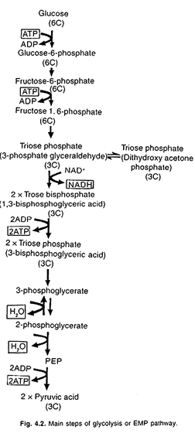

Slide 18
6. Krebs Cycle:
Sir Hans Adolf Krebs, discovered role of pyruvate in conversion of glucose hydrogens into fumarate. He discovered, in 1937, tricarboxylic acid cycle (i.e., TCA cycle), also known as Citric acid cycle or Krebs cycle. Citric acid cycle occurs in matrix of mitochondria. This cycle involves two decarboxylations and four dehydrogenations.
Various steps of these reactions are as follows:
The starting point of Krebs cycle is entrance of acetyl Co-A into a reaction to form citric acid. Krebs elucidated this cycle, and explained how pyruvate is broken down to CO₂and H₂O. For this pioneer work Krebs was awarded Nobel Prize in 1953.
In the first reaction of Krebs cycle, one molecule of acetyl Co-A combines with 4-carbon oxaloacetic acid (OAA); with the result 6-carbon citric acid is produced, and Co-A is released. This reaction is catalysed by enzyme citrate synthase.

Slide 19
Now, citrate (citric acid) is isomerised to isocitrate (isocitric acid).
Cis-aconitic acid is converted into isocitric acid with the addition of water in the presence of iron containing enzyme aconitase.

Slide 20
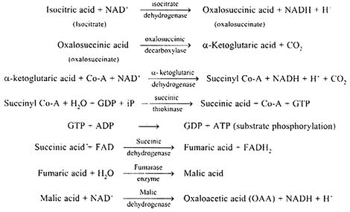

Slide 21
During citric acid cycle (Krebs cycle) 3 molecules of NAD⁺ and one molecule of FAD (Flavin Adenine Dinucleotide) are reduced to produce NADH and FADH₂, respectively.
During citric acid cycle NADH and FADH, are produced. Now, they are linked with electron transport system (ETS) and produce ATP by oxidative phosphorylation.
This may be summarised in following equation:
In the end of Krebs cycle, glucose molecule is completely oxidised. From one glucose molecule, two pyruvic acid molecules are formed. After oxidation of one pyruvic acid molecule, three CO₂ molecules are released. Thus, in all 6 molecules of CO₂ are released.

Slide 22
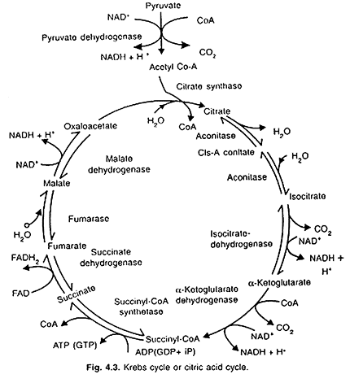

Slide 23
Electron Transport System (ETS):
By the end of Krebs cycle, glucose molecule oxidises completely, but the energy does not release till NADH and FADH₂ oxidise through electron transport system (ETS). The metabolic pathway through which electron passes from one carrier to another, is called electron transport system (ETS). The electron transport system is also known as electron transport chain or mitochondrial respiratory chain.
The electron transport system consists of a series of coenzymes and cytochromes that take part in passage of electrons from a chemical to its ultimate acceptor. The passage of electrons from one-enzyme or cytochrome to the next takes place with a loss of energy at each step. Electron transport system is operative in the inner mitochondrial membrane.
The electron carriers include flavins, iron sulphur complexes, quinones and cytochromes. Most of them are prosthetic groups of proteins.
Electron transport system in mitochondria consists of four complexes which are found in bases of stalked particles in the inner mitochondrial membrane, and also ubiquinone (UQ) or coenzyme Q and cytochrome c which are not bound to stalked particles but act as mobile electron carriers between the complexes.

Slide 24
Complex-I:
Consists of NADH-dehydrogenase or NADH-Q reductase which contains a flavoprotein FMN (flavin mononucleotide) and is associated with iron-sulphur (Fe-S) proteins. This complex is responsible for passing electrons (also protons) from mitochondrial NADH to ubiquinone (UQ), located within inner mitochondrial membrane.
Complex-II:
Consists of succinate dehydrogenase which contains a flavoprotein FAD (flavin adenine dinucleotide) in its prosthetic group and is associated with non heme iron-sulphur (Fe S) proteins.
This complex receives electrons (also protons) from succinic acid (which is oxidised in Krebs cycle to form fumaric acid) and passes them to ubiquinone (UQ). Ubiquinone also receives reducing equivalents via FADH₂ that is generated during oxidation of succinate, through the activity of energy succinate dehydrogenase, in Krebs cycle.

Slide 25
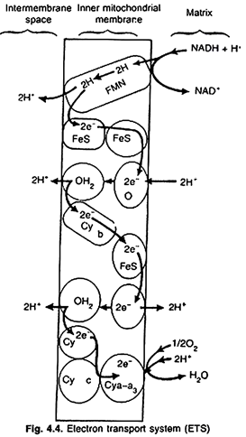

Slide 26
Complex-III:
Consists of ubiquinol, cytochrome c and cytochrome bc₁ .The reduced ubiquinone is called ubiquinol. Here ubiquinol is oxidised with the transfer of electrons to cytochrome c via cytochrome bc₁. Cytochrome c is a small protein attached to outer surface of the inner mitochondrial membrane and acts as a mobile carrier for transfer of electrons between complex III and complex IV.
This complex is called QH₂-cytochrome c reductase complex. This bears three components, i.e., cytochrome b, non-heme iron sulphur (Fe – S), and cytochrome c₁. Coenzyme Q is also involved between Fe-S and cytochrome c₁.
The equations are as follows:
Now, cytochrome c, transfers electrons to cy c. Like coenzyme Q, cy c is also mobile carrier of electrons.

Slide 27
Complex-IV:
Is known as cytochrome c oxidase complex. This contains cytochromes a and a₃, along with two copper centres. This complex receives electrons from cytochrome c and passes them to 1/2 O. Two protons are needed and Ho molecule is formed (terminal oxidation). Here, O₂ is ultimate acceptor of electrons. It combines with protons to form metabolic water or respiratory water.
Complex-V:
When electrons are transferred from one carrier to next carrier via complexes 1 to IV in electron transport system (ETS), they are coupled to ATP synthase enzyme complex for production of ATP from ADP and inorganic phosphate (iP).
Here, number of ATP molecules synthesised during ETS, depends on nature of electron donor. Oxidation of one molecule of NADH gives rise to 3 molecules of ATP, and one molecule of FADH₂ gives rise to 2 molecules of ATP. ATP synthase complex is called complex V.
During transportation of electrons, hydrogen atoms split into protons and electrons. The electrons are carried by cytochromes. Before last stage, where hydrogen atom is accepted by oxygen to form water, the electrons again recombine with their protons. Oxygen acts as final hydrogen acceptor.

Slide 28
Oxidative Phosphorylation:
The whole process, where oxygen effectively allows the production of ATP by phosphorylation of ADP, is called oxidative phosphorylation. In other words, synthesis of ATP is called phosphorylation, and as it takes place in presence of oxygen, it is called oxidative phosphorylation.
The enzyme required for synthesis of ATP, is called ATP synthase. This is located in F₁, or head piece of F₀ – F₁ or elementary particles. ATP synthase enzyme becomes active in ATP formation, where there is a proton gradient saving higher concentration of H₂.
ATP synthase, also known as complex V consists of two major components, i.e., F₁, and F₀. The F₁ headpiece is a peripheral membrane protein complex and contains the site for ATP from ADP and inorganic phosphate (iP).

Slide 29
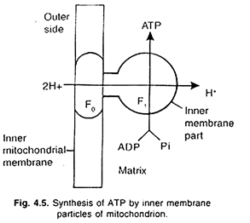

Slide 30
Whereas, F₀ is an integral membrane mitochondrial-protein complex which forms the channel through which protons cross the inner membrane. The passage of protons through the channel is coupled to the catalytic site of the F₁ component for the production of ATP.
Oxidation of one molecule of NADH₂ produces 3 ATP molecules whereas a similar oxidation of FADH₂ produces 2 ATP molecules.
Net gain of ATP:
Complete oxidation of glucose to CO₂ and water shows that there is a net gain of 38 ATP. Each NADH + H⁺ produces 3 ATP molecules, while FADH₂ forms only 2 ATP molecules at the end of reaction.
Thus, total gain of ATP in aerobic respiration is as follows:

Slide 31
However, in most eukaryotic cells, 2 molecules of ATP are required for transport of NADH produced in glycolysis into mitochondrion for further oxidation, and therefore, net gain of ATP is 36 molecules.
Significance of Krebs Cycle:
a. During Krebs cycle, carbon skeletons are obtained for use in growth and maintenance of the cell.
b. Many intermediate compounds are formed which are used in synthesis of other biomolecules, such as amino acids, nucleotides, chlorophyll, cytochromes and fats.
c. During this pathway amino acids are synthesised from α-ketoglutaric acid, pyruvic acid and oxaloacetic acid.
d. Here succinyl Co-A acts as starting molecule for synthesis of chlorophyll.
e. Krebs cycle is major pathway for generation of ATP molecules, which make energy currency of the cell.
f. Energy is released from glucose, and is used in various biochemical reactions.

Slide 32
g. Phenol, anthocyanin, etc., are produced from acetyl Co-A, whereas fatty acids are formed from glycerol.
h. Glutamic acid is formed from α-ketoglutaric acid; aspartic acid from oxaloacetic acid, and alanine from aspartic acid.
i. Amino acids are used in synthesis of proteins, nucleic acids, purines and pyrimidines.
j. Succinyl Co-A carries synthesis of pyrrole compounds of chlorophyll, cytochrome and phytochrome.
k. Krebs cycle is directly related to nitrogen metabolism, α-ketoglutaric acid, an intermediate of Krebs cycle is first acceptor molecule of NH₃ forming an amino acid, the glutamic acid. From glutamic acid various transamination reactions begin to form different amino acids which ultimately condense to form proteins.
l. Krebs cycle is also intimately related with fat metabolism. Dihydroxyacetone phosphate produced in glycolysis may be converted into glycerol via glycerol-3-phosphate and vice versa. After β-oxidation, fatty acids give rise to active 2-C units, the acetyl Co-A which enters the Krebs cycle.

